Slide 1
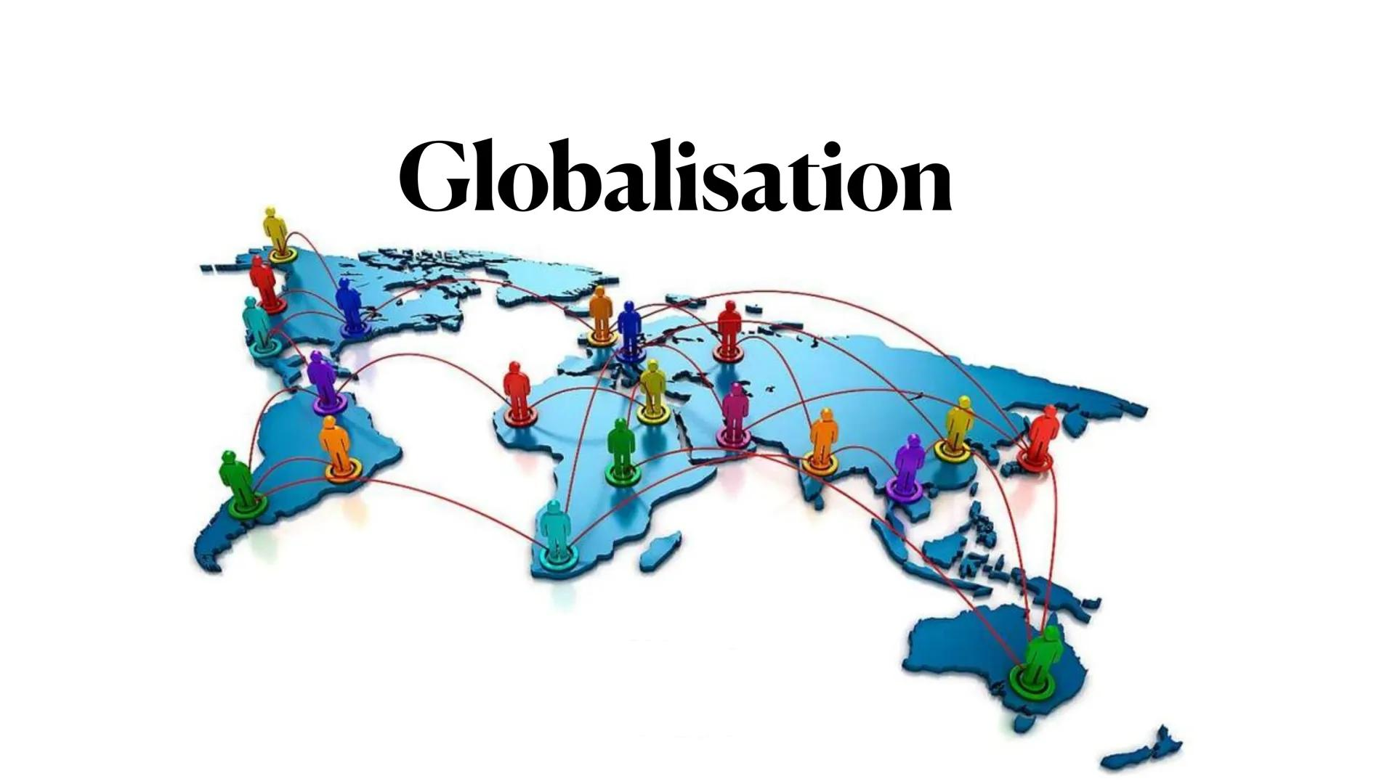
The Multifaceted Impact of Globalization Exploring Economic Drivers and Social Disparities through FDI, Trade, Income Inequality and indicators of Quality of Life
Assessing the impact of Globalisation on Economic, Social and Environmental dimensions (A Pre-Covid Analysis)

Slide 2
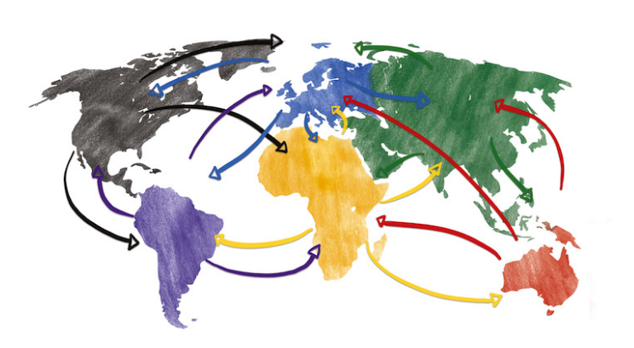
The Concept of Globalization: Perspectives from Economists
Amartya Sen: Sen sees globalization as a historical process of interconnectedness that fosters cultural, social, and economic exchanges, but stresses the need for inclusive policies to ensure equitable benefits
Joseph Stiglitz: Stiglitz viewed globalization as the integration of markets, technology, and communication across borders, often critiquing its unequal benefits and the exploitation of weaker nations by stronger economies.
Paul Krugman: Krugman emphasizes globalization as increased trade and economic integration, driven by comparative advantage and specialization, but acknowledges concerns like income inequality and labor displacement
Thomas Friedman: Friedman describes globalization as the flattening of the world through technological advances, allowing unprecedented connectivity and competition among nations and individuals.
David Ricardo: Although predating the term, Ricardo's theory of comparative advantage laid foundational ideas for globalization, advocating that free trade benefits nations by allowing them to specialize in efficient production.

Slide 3

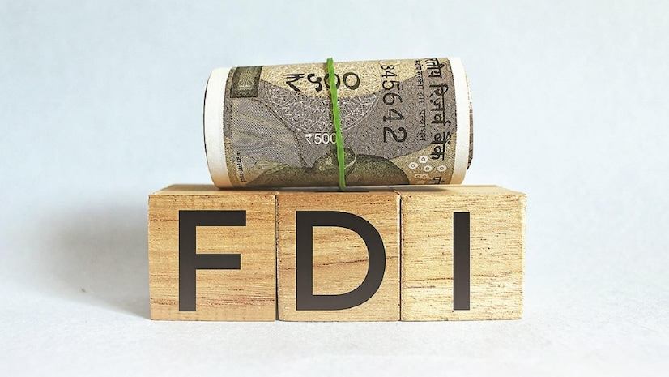
Globalization: Boosting Growth, and Empowering Innovation!
This trend reflects the spread of mobile technology and its integration into daily life in various regions, contributing to globalization by facilitating communication and connectivity.
The graph suggests that globalization has led to increased cross-border investments, with emerging markets becoming more attractive destinations for FDI.

Slide 4

These patterns reflect the rising integration of Emerging and Developing economies into global trade, with Developed economies maintaining a steady but less dynamic trade share compared to developing and emerging nations. shows the importance of remittances to each type of country. The graph suggests that globalization has facilitated increased migration and, consequently, a rise in remittances, particularly for emerging and developing countries. However, developed countries generally received lower remittances compared to emerging and developing countries.

Slide 5
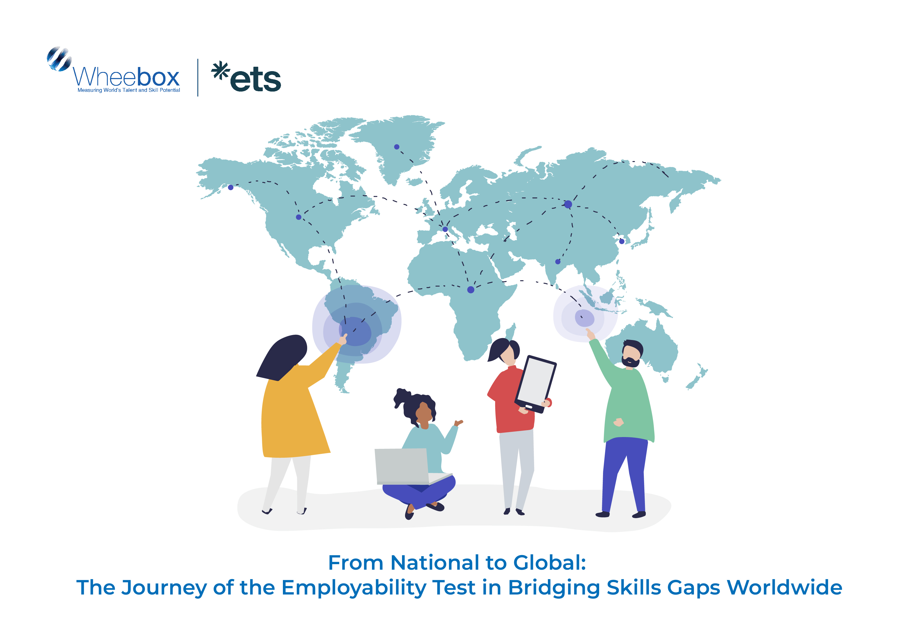
Does Globalization Truly Bridge the Gaps or Widen the Divides?
Developing countries have the lowest unemployment rates due to prevalent informal employment, while emerging economies face high, volatile rates from structural and economic vulnerabilities. Developed economies maintain moderate, stable unemployment through robust labor systems. Income inequality, measured by the GINI index, is lowest in developing countries due to uniformly low incomes. Emerging and developed economies show higher inequality, driven by globalization favouring wealthier groups, with rapid growth outpacing inclusive policies in emerging markets and widening income gaps in developed nations.

Slide 6
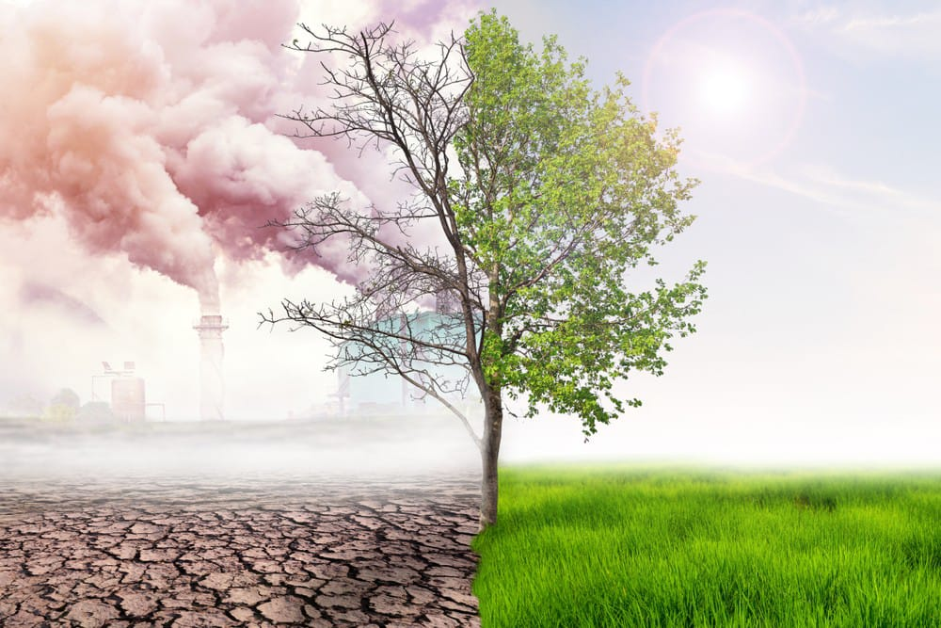
How does globalization impact environmental sustainability?
Globalization can drive environmental degradation but also promote green technology and global cooperation (Frankel, 2009). However, weak environmental regulations in developing countries often lead to resource exploitation and pollution, highlighting significant environmental costs despite economic gains (Dinda, 2004).
The first scatterplot(left) demonstrates that as globalization increases, deforestation rates also rise, driven by the global demand for agricultural products, timber, and land for industrial expansion. Similarly, the second scatterplot(right) shows a positive relationship between globalization and CO₂ emissions, reflecting increased industrial activity, transportation, and energy use associated with global trade and economic integration.

Slide 7
Results and findings based on the regression analysis carried out

Slide 8
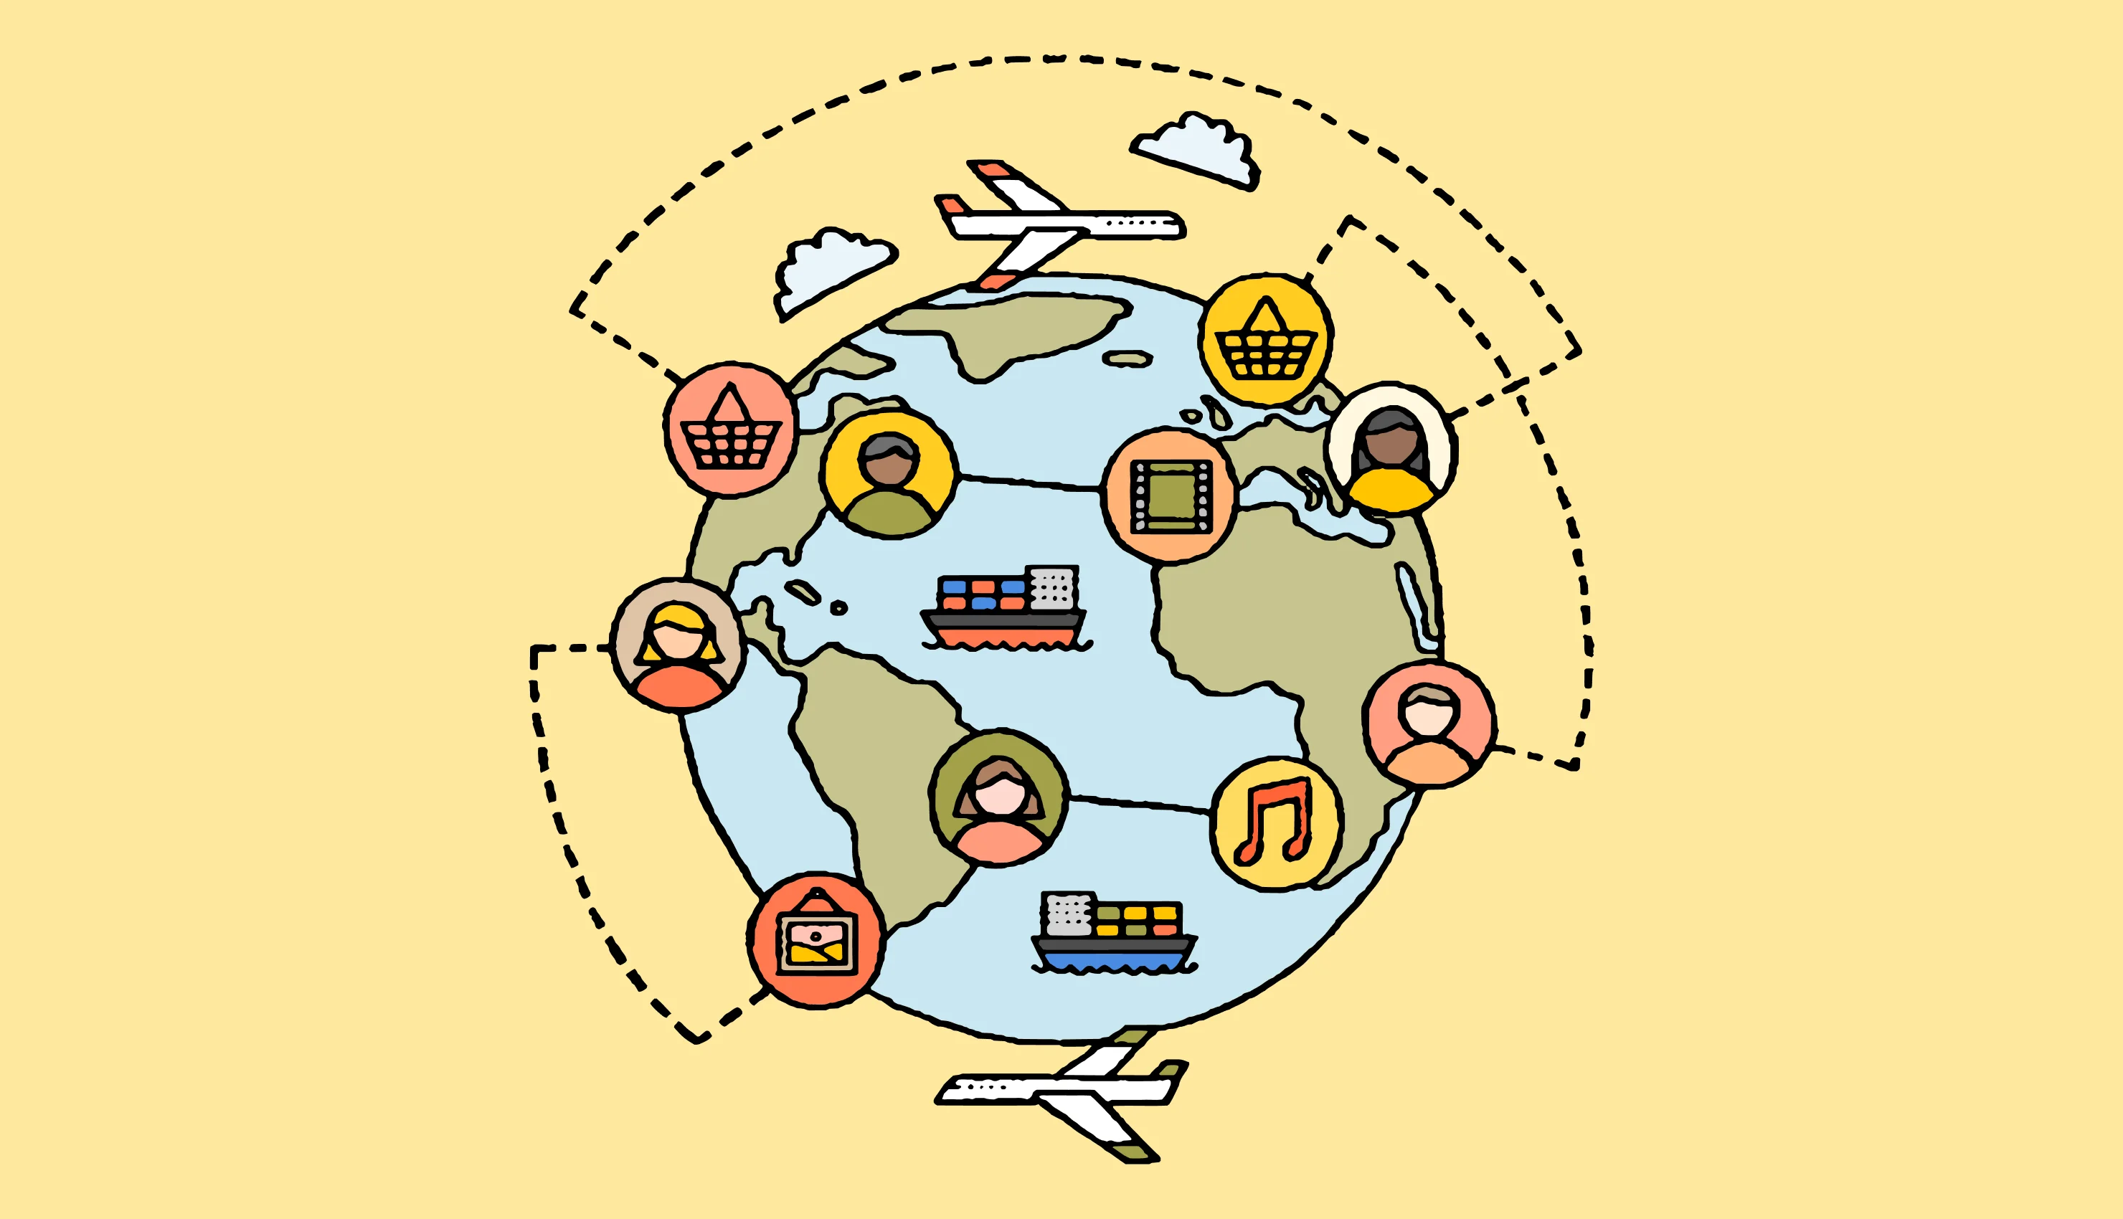
STUDY 1: Impact of Economic Globalisation on Social Life, measured by HDI
Research hypothesis: Factors like Trade ,FDI, GDPPC, ICT services export and remittances received is likely to have a positive effect on human development across the countries especially for on the lower and lower middle income countries.
The Human Development Index (HDI) measures a country's average achievements in human development across three dimensions: health, education, and standard of living. HDI = (Health Index *Education Index *Income Index)^(⅓).
By plotting the HDI data over the years after the offset of globalization, we see a pretty decent upward trend of HDI along the years for both developing and emerging countries for the pre covid period. While the developed country already has a very high HDI and is stable throughout the years. We have further analyzed the association of HDI with several economic variables which were important after globalization to confirm our hypothesis.

Slide 9
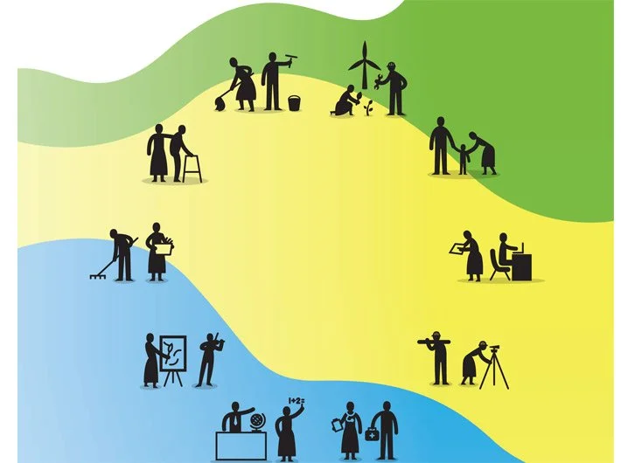
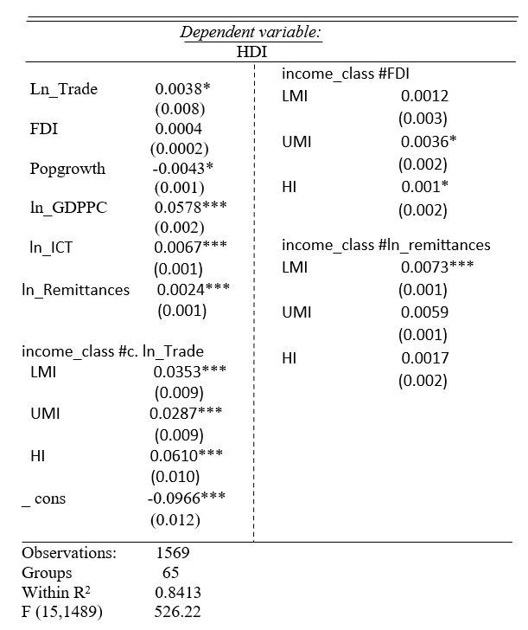
The regression analysis suggests that while globalization has facilitated international exchanges for many low-income countries, trade flows have a less significant impact on their HDI compared to countries in other income groups.
FDI seems to have no major role in boosting HDI for the lower income countries but somewhat does little effect on the higher income countries.
Remittances has mostly helped low income countries in their human development.
Growth of the ICT sectors has been a significant factor behind the betterment of living standards post globalisation.
With increase in demography of a nation it has affected the living standards of the residents.
And as globalisation helps narrow the income inequality across nations by increasing the income of people it also helps in boosting better life.
* 10% LOS ** 5% LOS ***1% LOS

Slide 10

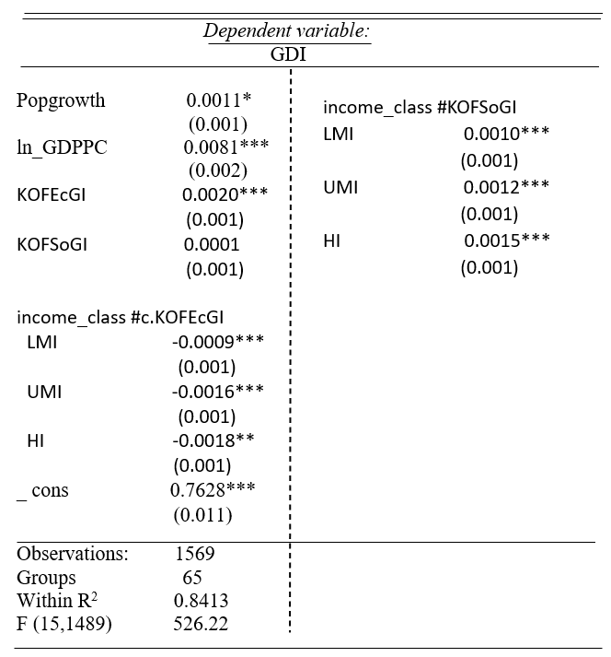
STUDY 2:Impact of Globalisation on Gender Development, measured by GDI
Research Hypothesis: Economic globalization (KOFEcGI) and Social globalization(KOFSoGI) most likely have a positive effect on GDI, thus expecting the gender disparities to narrow as a nation moves towards a developmental base
Gender development Index(GDI) measures a country's gender development by assessing the gaps between men and women in education, life expectancy, and wealth. GDI is the ratio of female HDI to male HDI
Here, Economic globalization is found to have a positive impact on gender equality by fostering economic integration. However, the strength of this relationship diminishes as income levels rise
Similarly social globalisation, has positive and significant effects on all the different income group countries except the lower income countries due to lack of proper governance, infrastructure also because of typical social and cultural norms.

Slide 11
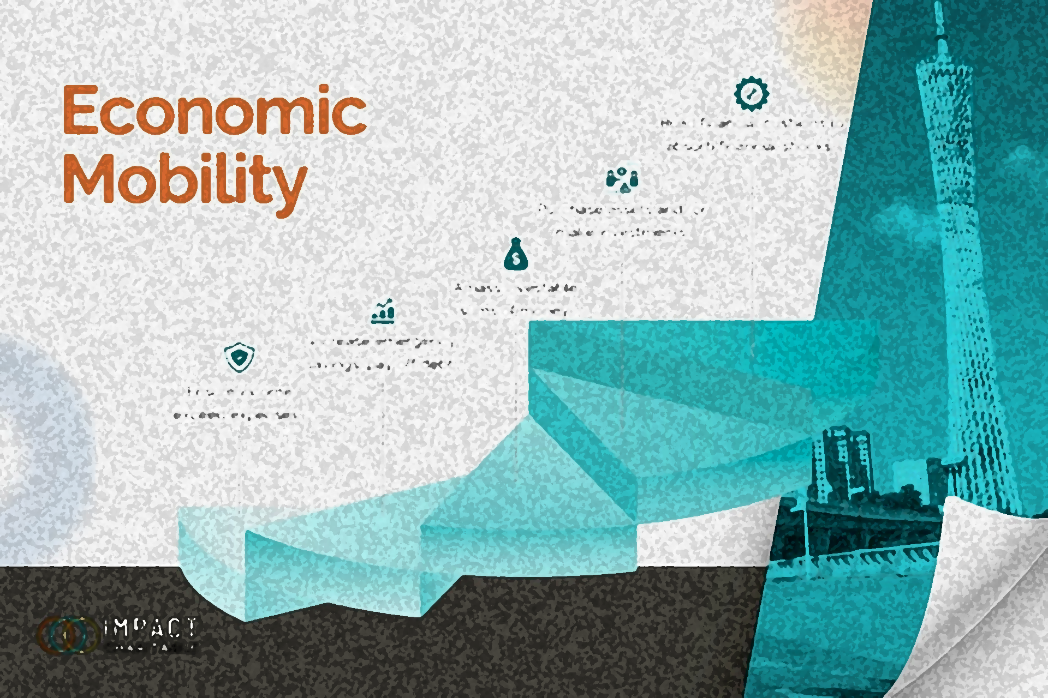
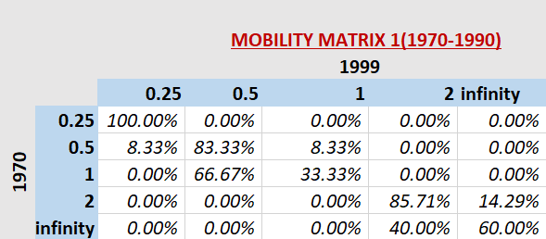
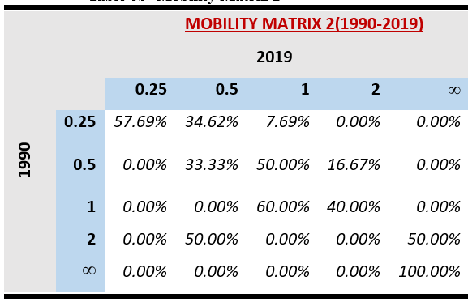
Study 3: (Analysing Socio-Economic Mobility pre vs post Globalisation)
Income transitions experienced strong persistence in the earlier period (1970-90) with limited upward movement, a symptom of rigidly structured economic hierarchies in many places ,reflecting restricted access to global markets and resources. For instance, 100% of entities in the lowest income category (0.25) persisted there, and very few left this category for higher ones, indicating no significant economic possibility
Whereas within the 1990–2019 period, there was high mobility upwards, especially for the lower income groups, as only 57.69% of entities persisted in the lowest category, while many climbed up to levels such as (1/2) and (1). However, the highest income class still persisted at 100% with the same entities. This reallocation aligns with the increased depth of global integration described by increased openness in international trade, technology, and education, especially in developing economies

Slide 12
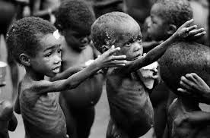
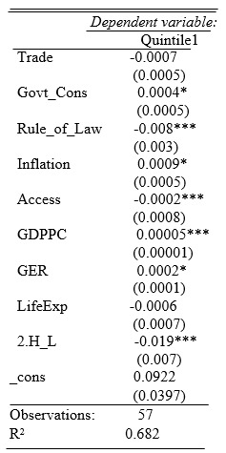
Study 4: How Do the Poor Fare Against Globalization?
Research Hypothesis: Globalization positively affects the income share of the bottom quintile.
Key Variables: Globalization indicators: Trade and Rule of Law. Control variables: GDP per capita, banking infrastructure, life expectancy, government consumption.
Findings
Trade and Rule of Law show weak or negative associations with the income share of the lowest quintiles, suggesting that the poor are excluded from globalization’s benefits due to lack of access to markets, banking infrastructure, and weak governance.
Limited Access to Resources: Access to markets and banking is critical for the poor to benefit from globalization. Life expectancy and government consumption have limited impact due to inadequate support for vulnerable groups.
Study of Dollar & Kraay (2004) supports these findings, showing that globalization’s benefits are disproportionately captured by wealthier segments of society, leaving the poor at a disadvantage.

Slide 13

WAY FORWARD
Inclusive Growth: Promote fair wages, progressive taxation, and SME support, with strong social safety nets and affordable education.
Healthcare & Education: Invest in healthcare, preventive care, and modern education, with incentives for school attendance and sustainable jobs.
Gender Equality: Ensure equal pay, scholarships, financial access, and anti-discrimination laws, while addressing gender-based violence.
Global Collaboration: Promote fair trade, corporate accountability, and digital inclusion (e-governance, telemedicine, e-learning).
Equity in Globalization: Globalization should balance progress with equity for a fairer global society.

Slide 14
THANK YOU!
Presented by: Ivan Das Prantika Mukherjee (Presidency University)

